Slide 1
Extend your Azure practice anywhere with Azure Arc and Azure Stack HCI

Slide 2
Agenda
Customer Reality and Market Trends
HCI opportunity
Hybrid reality
Introducing Azure Stack HCI and Azure Arc
Partner opportunity in industries
Opportunity qualification
Licensing and pricing
Resources

Slide 3
Durable customer reality
90%
93%
of enterprises remain hybrid
of enterprises have a multi-cloud strategy
Legacy systems / custom requirements
Regulations and data sovereignty
Latency and technical hurdles
Consequence of no proactive strategy
Key Drivers:
Source: Gartner Says a Massive Shift to Hybrid Infrastructure Services Is Underway
Source: Cloud Computing Trends: 2020 State of the Cloud Report | Flexera Blog

Slide 4

The future of infrastructure is hybrid
+12.5%
Y/Y increase in cloud infrastructure spending, to $15.1 billion
+6.3%
Y/Y increase in non-cloud infrastructure spending,
to $13.5 billion
International Data Corporation (IDC),
Worldwide Quarterly Enterprise Infrastructure Tracker, July 1, 2021
https://www.idc.com/getdoc.jsp?containerId=prUS48050621

Slide 5
Extending the cloud opportunity everywhere Large TAM; millions of on-premises servers, double digit growth in containers
Cloud and infrastructure
~12m on-premises physical servers growing to ~15 million by 2024¹
~50-70m on prem virtual machines growing to 80-90m by 2024²
Cloud-native apps
Use of containers growing from 70% to ~90%³
Large enterprises shift to containers
On-premises data
Steady $28B on-premises RDBMS revenue from 2020 to 2024⁵
75% of enterprise data will be created on the edge by 2025, up from <20% today ⁴
Hyperconverged
The total HCI Market is currently growing at ~9% YoY and is expected to be $13B by 2023
IDC Enterprise Infra Tracker; 2. Assumption: 1 physical servers = ~4 virtual machines, 3. CNCF, production and development 4. “Edge Computing Solutions for Industrial IoT” July 2018, Gartner. Microsoft (2020), 5. IDC RDBMS 5-year forecast Dec‘
Notes:
When we look at the actual numbers behind the continuum we see there’s a varying degree of additional revenue and gross margin associated with each bucket.
Starting from the top left we have basic strategy assessment services, services spanning from infrastructure migration, app modernization, to application development, all the way to two reoccurring revenue streams of managed services and software IP sales. There’s a wide opportunity for additional revenue and more and more Azure partners have been flexing from their core business in pursuit of higher margins.
Many companies have added capabilities through standing up new practices, acquisitions, or partnering with other complementary organizations. Azure has enabled a lot of our partners to take advantage of the opportunity through our deep partner ecosystem: finding the right partners, knowledge sharing, or access to our customer base.

Slide 6


Hyperconverged is the bridge to Hybrid Cloud
‘With 89% of respondents indicating they use HCI for cloud installations’
Hyperconverged infrastructure
TBR Hyperconverged Platforms Customer Research | 2H19
Notes:
TBR Findings
A significant 89% of respondents indicated they are leveraging HCI for either a private or hybrid cloud installation. Sixty-seven percent are doing so for hybrid cloud specifically. TBR believes the responses for hybrid and private cloud deployments have to be considered in totality. Private cloud decreases most often come as respondents increase their hybrid cloud deployment. Regardless of cloud deployment variant, these respondents are opting for HCI as the underpinning infrastructure.
As such, TBR believes HCI vendors can benefit from aligning their market messaging with this cloud-centric desire by customers. Cloud enablement is of rising concern to customers as they continue their digital transformation journeys.

Slide 7
Hyperconverged Infrastructure Market Revenue
2015
51% CAGR
2020
12% CAGR
2025

Slide 8
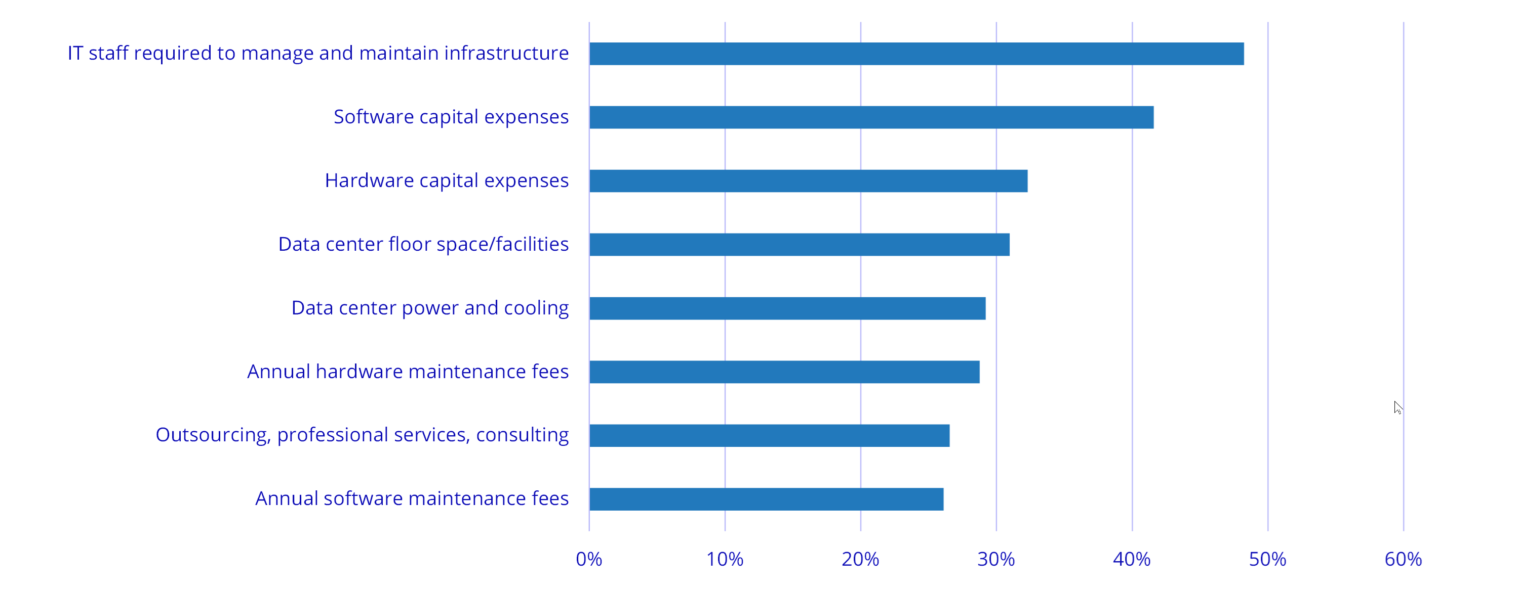
Improved Productivity & Reduced CAPEX Top Areas of Budget Savings Directly Attributable to HCI Deployments
N=226 Source: IT Infrastructure plans for 2021 Survey, IDC, December 2020
© IDC

Slide 9
Hybrid and multicloud change everything
Limited visibility Inconsistent governance
Tool incompatibility, skill variations, version control, DevOps
Migration
App modernization and innovation
Time-intensive management of patching, backup, HA, etc.
Cloud and infrastructure management
Data modernization
Purchasing inconsistency: Capex and Opex | Traditional licensing and subscriptions
Governance, compliance, and security
Notes:
Hybrid is causing pain for partners
There is no consistent view into all the assets meaning there is no consistent management, security or governance
The varied flavors of customer databases have different end of support dates that need to be managed.
They also require different tooling, different expertise, and separate manual patching, deployment, backup and HADR.
It is hard to quickly react to customer needs and slow to implement the DevOps practice of CICD as it’s time consuming to set up for the databases. (continuous integration and continuous deployment)
...

Slide 10



Innovation anywhere with Azure
Hybrid and multicloud
Azure
Single control plane with Azure Arc
Bring Azure services to any infrastructure
Modernize datacenters with Azure Stack HCI
Extend to the edge with Azure IoT

Slide 11
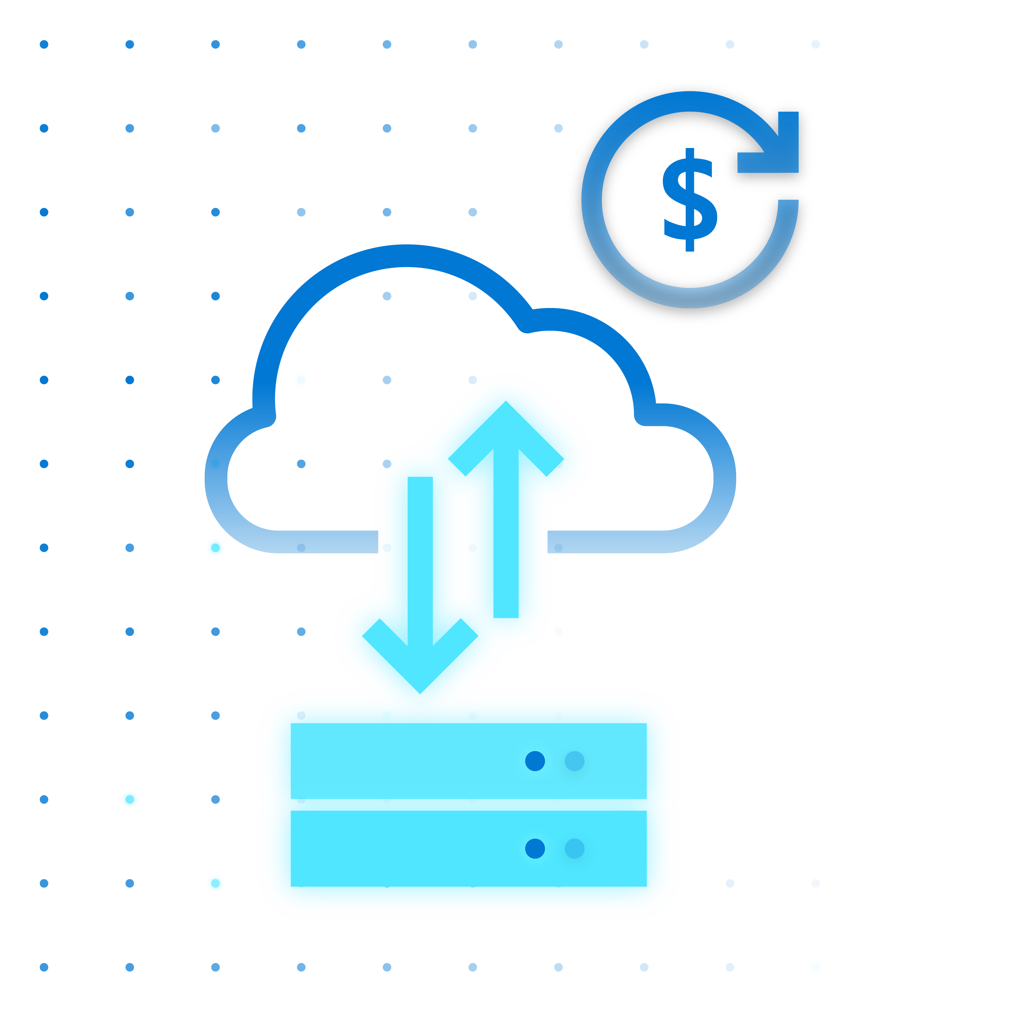

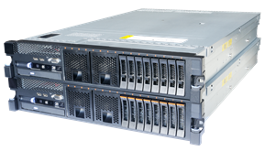


Modernize datacenters with Azure Stack HCI
Azure Stack HCI
Azure hybrid by design
Modern subscription for flexible, familiar hyperconverged infrastructure
Enterprise scale and price performance
Familiar management and operations
Choice of deployment options

Slide 12

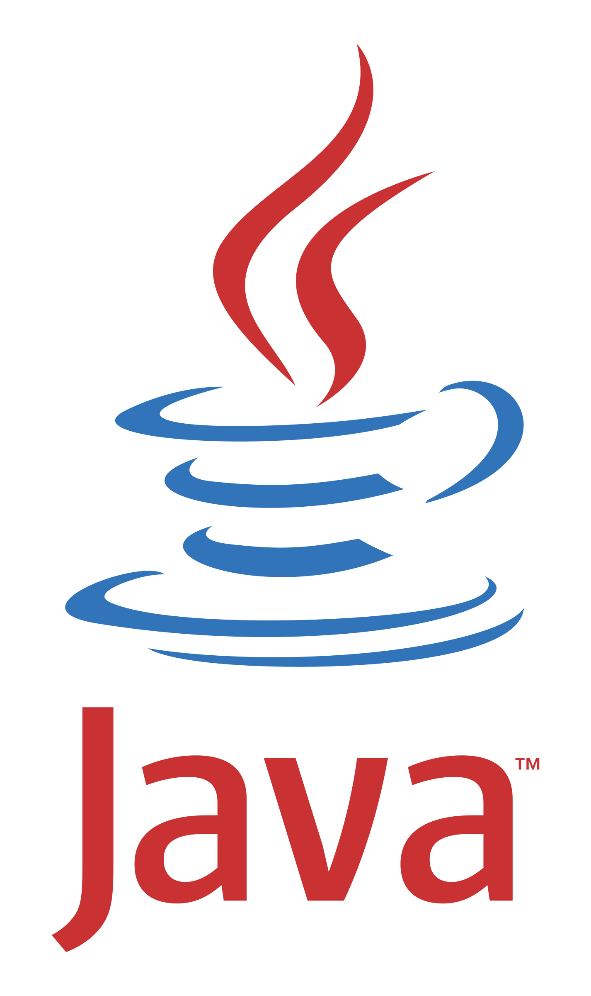








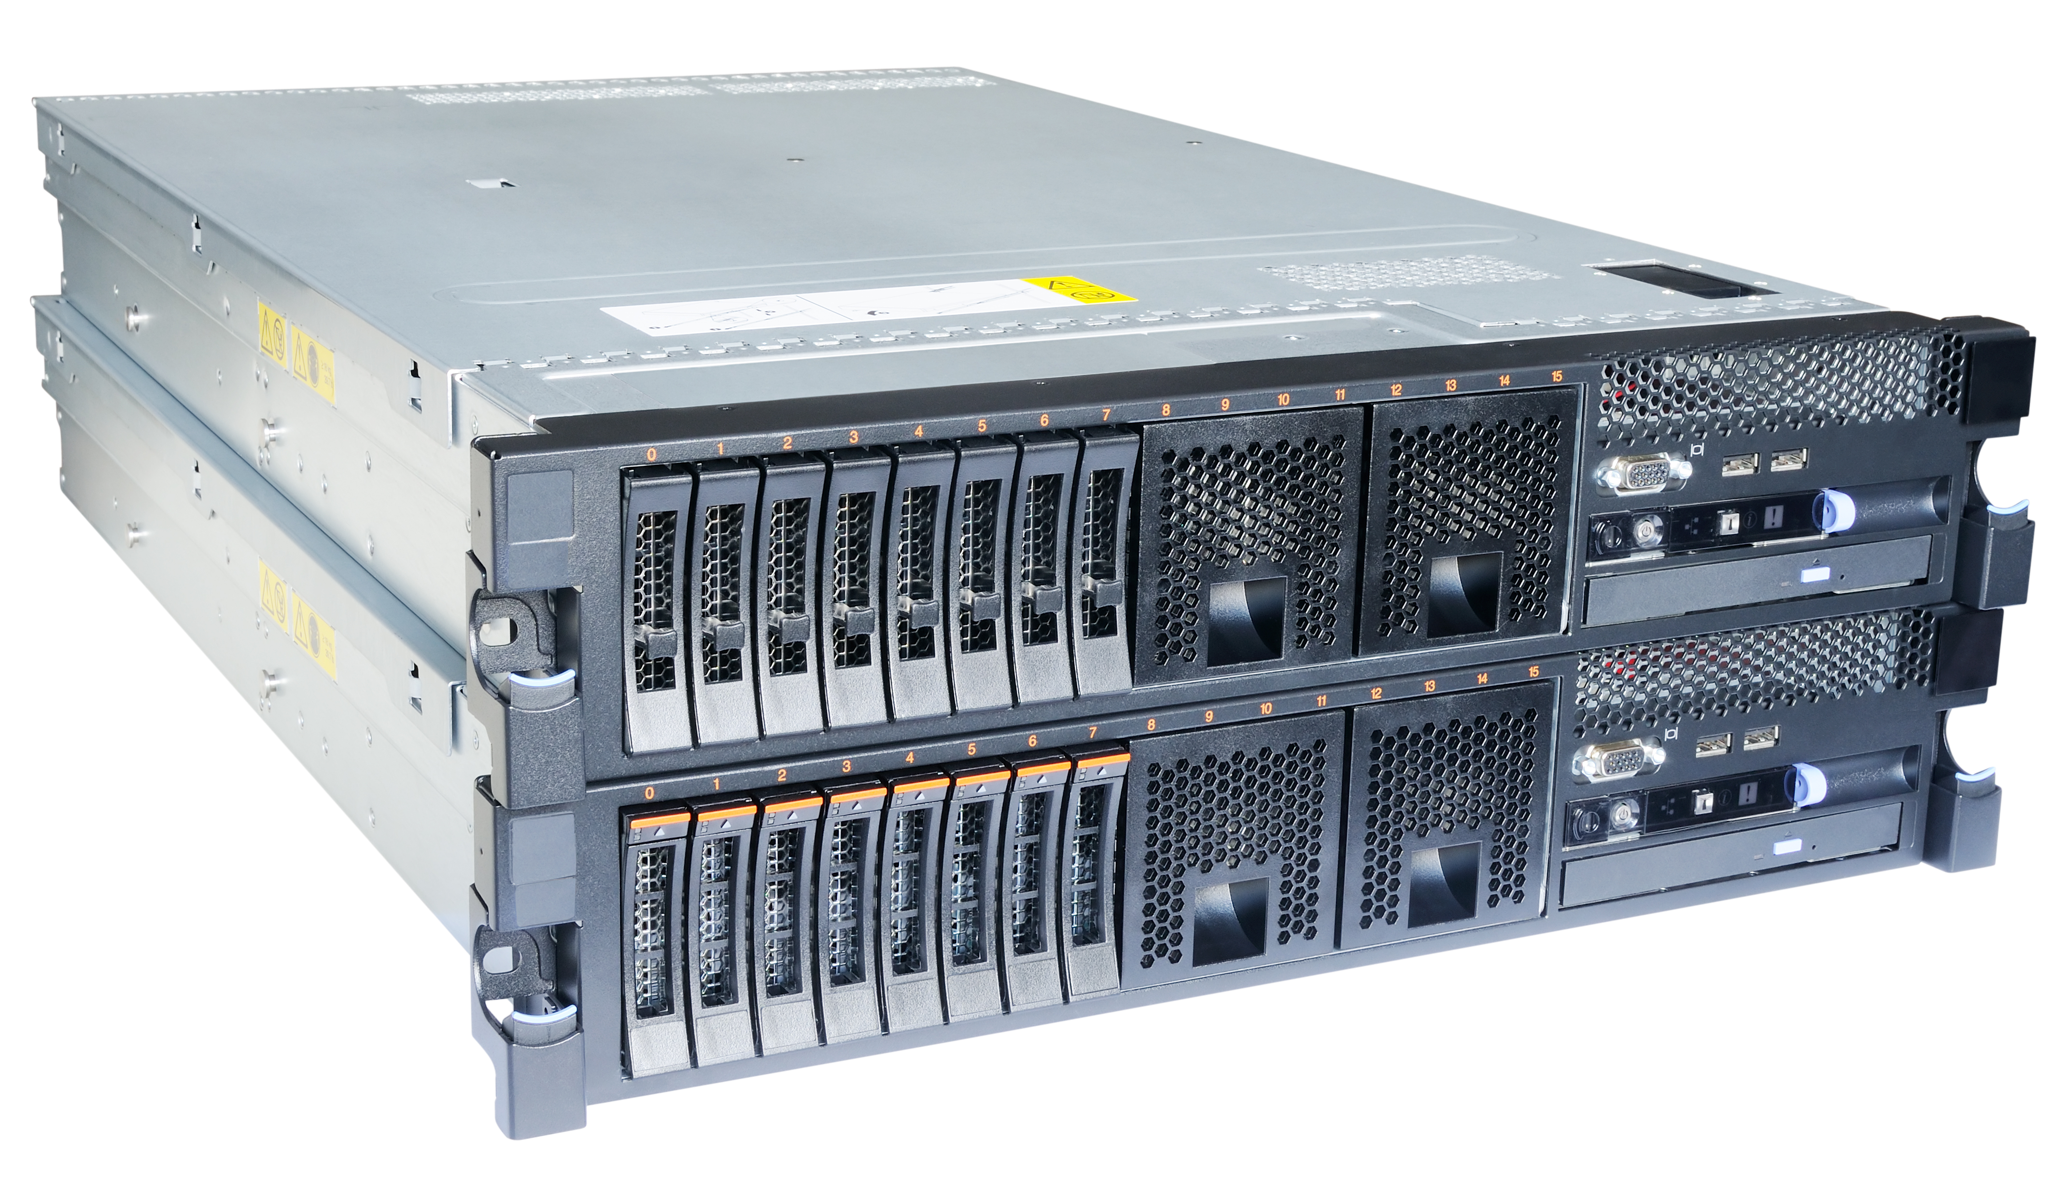
Flexibility with Azure to do it all
Management services
Cloud native applications
Azure Arc-enabled data services
Monitoring | Policy | Defender | More…
Container Management
Familiar management, operations and deployment flexibility
AKS on Azure Stack HCI
Azure Arc-enabled
Datacenter Modernization
Flexible for VM and cloud native with AKS on Azure Stack HCI
Azure Stack HCI
Enterprise scale and great price-performance
Notes:
How to go all in with Azure
How to enable a Hybrid strategy with Azure
Flexibility with Azure to do it all
If you are looking for a fully managed Kubernetes solution on-premises in your datacenters and/or edge locations, AKS on Azure Stack HCI is a great option. AKS clusters on Azure Stack HCI can be connected to Azure Arc for centralized management. Once connected, you can deploy your applications and Azure data services to these clusters and extend Azure management services such as Azure Monitor, Azure Policy and Azure Defender.

Slide 13





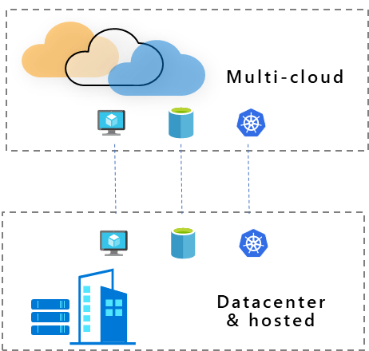

Azure Arc
Extend Azure management and services anywhere
Multi-cloud
Datacenter & hosted
Gain central visibility, operations, and compliance
Build Cloud native apps anywhere, at scale
Run Azure services anywhere
Integrate with existing partner systems, no rip and replace required
Built with Azure Lighthouse – multi-tenancy by design
Notes:
With Azure Arc, you can benefit in 3 different scenarios. Arc helps you accelerate innovation across hybrid and multi-cloud environments with simplified management, faster app development, and consistent Azure services.
1) First, if you have workloads running outside Azure, you can centrally manage all these resources consistently in Azure, whether they are Windows, Linux, SQL Server or Kubernetes clusters. You can govern, organize, and inventory assets in a homogenous way and get central visibility to them from a single pane of glass, all from within Azure. This helps you meet governance, compliance, and organizational standards through policies for all your apps, infrastructure, and data.
2) Next, Azure Arc helps you build cloud native apps anywhere, at scale. You can leverage the modern cloud native app development practices, meaning you can use DevOps techniques to deploy and manage Kubernetes apps at scale on your choice of any certified Kubernetes distribution. You can also reduce errors with consistent configuration and policy-driven deployment and operations for applications and Kubernetes clusters. Use Arc to centrally manage and delegate access for DevOps roles and responsibilities.
3) And lastly, you can run Azure services such as Azure SQL Managed Instance and Azure PostgreSQL Hyperscale anywhere. With Azure Arc, you can implement cloud practices and automation to deploy faster, consistently, and at scale with always-up-to-date Azure Arc enabled data services.

Slide 14
Example Opportunities
Financial Services
Optimize
Innovate
Manufacturing
Cloud Migration
Point of sale application
Retail
Healthcare
Governance, compliance, management, and security
E-commerce application
Government
Next-gen inventory application
Data modernization
Education
Energy

Slide 15







Optimize Migration, governance, compliance, management, and security
Scenario: A customer has 100 VMs (Linux/Windows + SQL) running on-premises. The VMs consist of file servers, SQL instances, web servers and backend servers. You as a partner have been brought in to conduct an analysis of the infrastructure, execute the migration and implement a unified operations strategy using Azure native tools.
Azure Policy
$6/Azure Arc enabled server/month per Guest Config Policy
+ Sentinel ACR $
50 x Azure Arc enabled Servers
Migration
50 x Azure VMs + Sentinel
50 x On-Premises VMs
50 x Azure VMs
50 x Azure Arc enabled Servers + Sentinel
100 x On-Premises VMs
ACR $ generated
from the migration
+
Sentinel ACR $
Notes:
We are starting with 100 on-premises virtual machines, generating 0$ ACR
By migrating 50 of these VMs to Azure, we are generating ACR only for these 50 VMs but “leaving money on the table” for the other 50 on-premises VMs who “stayed behind”
We are now enabling Azure Sentinel for the 50 Azure VMs which generates more Azure ACR but we are still not generating ANY ACR for the “stayed behind” on-premises VMs
Now, by onboarding the 50 on-premises VMs into Azure Arc, which does not have a cost, we are making progress towards generating ACR for the on-premises VMs
By applying Azure Policy, which will enforce Azure Sentinel on all 50 on-premises Azure Arc enabled servers, we are now generating 6$ per Azure Arc enabled server via Azure policy as well as ACR $ coming from Azure Sentinel This means we are maximizing the ACR opportunity and no longer leaving money on the table!
This example shows the potential of “unlocking” an Azure service such as Sentinel for on-premises assets which without Azure Arc, would have not generate any ACR,
Like Azure Sentinel, other Azure services can be unlocked using Azure Arc. Services such as (but not limited to) Azure Security Center, Azure Monitor, Azure Log Analytics, etc. can now all be applied and utilized by Azure Arc enabled servers.

Slide 16




Optimize Migration, governance, compliance, management, and security (cont.)
Scenario: A customer has 100 VMs (Linux/Windows + SQL) running on-premises. The VMs consist of file servers, SQL instances, web servers and backend servers. You as a partner have been brought in to conduct an analysis of the infrastructure, execute the migration and implement a unified operations strategy using Azure native tools.
Azure Policy
$6/Azure Arc enabled server/month per Guest Config Policy
+ Sentinel ACR $
50 x Azure Arc enabled Servers + Azure Services
Migration
50 x Azure VMs + Sentinel
ACR $ generated
From the migration
+
Sentinel ACR $
+
ACR $ generated from running VMs on Azure Stack HCI at $10 per core/month
Azure Stack HCI
Other Virt
Bare-metal
Notes:
This example shows the potential of “unlocking” an Azure service such as Sentinel for on-premises assets which without Azure Arc, would have not generate any ACR,
Like Azure Sentinel, other Azure services can be unlocked using Azure Arc. Services such as (but not limited to) Azure Security Center, Azure Monitor, Azure Log Analytics, etc. can now all be applied and utilized by Azure Arc enabled servers.

Slide 17
Innovate Customer requirements: Solution migration, modernization, and development
Point of sale application
E-commerce application
Next-gen inventory application
Pre-cloud application
Runs in datacenter and retail locations
3-Tiered Windows/Linux/SQL arch.
It is no longer in active development
Strict change management practices
Cloud-native microservices application
Deployed in multiple locations and clouds
Needs global reach and comply with local regulatory requirements.
It’s under active development
Prototype application to monitor stock levels on shelves in store.
Leverage edge devices
Local ML models for real-time analysis
Integrated with existing systems
Models are trained & managed through scale-out cloud services.
VMware, no hybrid management, no clustering (too expensive), thousands of store locations
Legacy Hyper-V x 2 servers, not clustered, not hyperconverged, local storage only, hundreds of stores
Mix Nutanix and Hyper-V, manufacturing and distribution centers around the US, 2 datacenters and ~30 “edge” sites

Slide 18
Innovate Partner opportunity: Solution migration, modernization, and development
Point of sale application
E-commerce application
Next-gen inventory application
Organize and inventory Windows and Linux
Manage SQL servers in store at scale
Compliance with Azure Policy
Attach Azure Security Center
Cloud patching with Azure Update
For cost reduction, move VMs to Azure Stack HCI clusters
Solution design and development
Implement a GitOps model
Azure Policy for K8s app management
Azure Monitor for telemetry
Run on AKS on Azure Stack HCI clusters
Solution design and development
Implement a GitOps model
Azure ML for training in public cloud
Build using Azure Arc enabled data and ML for local scoring (simplest infrastructure would be AKS on HCI)
Run Azure ML on Arc enabled K8s
For 30 edge sites there may be significant cost savings migrating to Azure Stack HCI due to 2 nodes model (other HCI platforms start at 3 nodes)

Slide 19
Opportunity Qualification
Hybrid Situations
Regulation
Data Privacy
Connectivity
Latency
Legacy
Strong Opportunity:
Cloud first mindset
LOB / Central IT Alignment
IT Sprawl
Needs more qualification:
Large scale VMware replacement
Air Gapped requirement

Slide 20
Azure Stack HCI Licensing
Host | Azure Stack HCI - Leverage the software defined datacenter features and add new features specifically for Azure Stack HCI
Guest | Windows VMs and Unlimited Linux VMs - Windows VMs monetized via Windows Server License
Management | Windows Admin Center, Azure Arc - Other tools possible Arc-enabled for at scale management, monitoring
Channels | EA/CSP/Web Direct - Price list active dates: CY2021
Pricing Model | Monthly subscription - No Cost ESU for Windows Server & SQL Server 2008/R2, Windows Server 2012/R2 & SQL Server 2012 workloads
List Price | USD$10/physical core/month
Support | Azure/Premier support
Minimum buy-in | 1 core
Trial | 60 days free
Languages | (18) Czech, German, English, Spanish, French, Hungarian, Italian, Japanese, Korean, Dutch, Polish, Portuguese-Brazil and Portugal, Russian, Swedish, Turkish, Chinese-Simplified and Chinese-Traditional (Taiwan)
Modern subscription for flexible, hybrid hyperconverged infrastructure
Create Azure affinity: customers can only purchase via modern Azure channels
“Always up to date” product that requires Azure connectivity
Offers flexibility to add commitment-based offers in future

Slide 21


What does Azure Stack HCI charge for?
Cores
80
70
60
50
40
30
20
10
Cores from running virtual machines
USD $10/month
per physical processor core*
Physical cores
*Does not include Guest OS licensing
0 1 2 3 4 5 6 7 8 9 10 11 12 13 14 15 16 17 18 19 20 21 22 23 24 25 26 27 28 29 30
Days
Predictable
Doesn’t vary with consumption, more VMs doesn’t cost more
Simple
No math with memory, storage, or network ingress/egress
Rewards
Those who virtualize efficiently, with higher v-to-p density

Slide 22

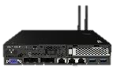

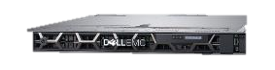


Costs scale predictably from edge to datacenter
Example of scale based on actual offering – not reflective of all OEM solutions
PRIMERGY TX1330 M4
4 cores
Cost per server
$40 /month
ThinkAgile MX1021
8 cores
Cost per server
$80 /month
Integrated System AX-640
16 cores
Cost per server
$160 /month
ProLiant DL 380 Gen 10
24 cores
Cost per server
$240 /month
No minimum or maximum
(starts from 1 core for 1 day)

Slide 23



Virtual machine licensing opportunities
Sell as much Windows Server as customer needs, adjust for environments (ROBO, ROBO/Mid-market, Datacenter)
Quick Sales Tips:
If 1-6 Windows VMs, Sell 1-3 Windows Standard Edition
If >6 Windows VMs, sell Windows Server DC
You can now leverage automatic virtual machine activation (AVMA) to deploy guest licenses easily
Typical environment:
ROBO/Mid-market (not a traditional Microsoft shop)
Linux applications
Open-source software
OEM HW
+
Azure Stack HCI
+
Nothing else needed
See provider if fees apply
ROBO/Mid-market
A few Windows Server roles or applications
Validated OEM HW
+
Azure Stack HCI
+
Windows Server 2019 Standard(s)
Datacenter
Unlimited Windows Server roles or applications
Validated OEM HW
+
Azure Stack HCI
+
Windows Server 2019 Datacenter
Customers want to run:
What to buy:
Host: Subscription
Guest: Perpetual

Slide 24

Azure Arc enabled server pricing update Azure Arc can manage Windows Servers and Linux Servers on-premises, edge, and multi-cloud
Additional services
Azure Policy—guest configuration
Azure Monitor
Azure Defender—Standard
Azure Sentinel
Backup
Log Analytics
Service Map
Application Insights
Network Watcher
Azure Sentinel
Config and Change Management
No additional cost
Control plane functionality:
Tagging, management groups, activity logs, templates, Resource Graph, RBAC
Customer servers and clusters
Aka.ms/AzureArcPricing

Slide 25
Azure Stack HCI Partner Training & Resources
Go to market with sales & marketing resources
Get your team ready with sales & technical training
Engage with technical resources & forums
Learn how to expand your opportunity
Customer Ready Materials
L100 Azure Hybrid Overview
Customer FAQ
10 Azure Stack HCI Facts
Azure Stack HCI Datasheet
Datacenter Modernization E-book
Five Hybrid Cloud Use Cases E-book
Azure Stack HCI Hybrid Cloud Essentials E-book
ESG Analyst Report
ISV Solution Briefs for Azure Stack HCI
Win Hybrid with Azure Arc & Azure Stack HCI MPN campaign
Video Library
Azure Stack HCI Comprehensive Demo
Azure Virtual Desktop for Azure Stack HCI
Securing Azure Stack HCI with Azure Defender & Secured-core
Discover the new Azure Stack HCI
The next generation of Azure Stack HCI | Azure Friday
Product tour of the new Azure Stack HCI using WAC
Getting Started with AKS on HCI
Disaster Recovery with Stretch Clustering
On Demand Training
Partner Readiness Bootcamp
Hybrid Infrastructure events for services partners:
Azure Stack HCI - Growing your Services Business Training
Azure Stack HCI - Technical Deep Dive Training
Azure Arc - Growing your Services Business Training
Azure Arc - Technical Deep Dive Training
Learning Paths
Azure Stack HCI foundations
Operate and maintain Azure Stack HCI
Fall 2021 Ignite Sessions
Learn everything about the new Azure Stack HCI feature update
Secure, develop, and innovate in hybrid and multicloud with Microsoft Azure
Technical Content
Technical Documentation
Evaluation Guide
Technical Feature Videos
Kernel Soft Reboot
Every Node Arc-Enabled
Intent Driven Networking
GPU Management
Multi-cluster Monitoring
Automatic Virtual Machine Activation (AVMA)
Reference Architecture
Stretched clusters for disaster recovery
Switchless interconnect and lightweight quorum for remote office/branch office
Forums
Technical Q&A
Feedback Forum
Azure Stack Tech Community
To Partner Materials
Partner Opportunity Deck
Video: Modernize your customers’ hybrid applications and grow your services business with AKS on Azure Stack HCI and Azure Arc
Advanced Specializations
Hybrid Cloud Infrastructure with Microsoft Azure Stack HCI
Hybrid Operations and Management with Microsoft Azure Arc
Catalogs
Azure Stack Partner Catalog
Azure Stack HCI Hardware Catalog
Sales Program
Azure Stack HCI Accelerator Program
For sales assistance from Microsoft, contact the Azure Stack HCI Field support team

Slide 26


Microsoft Learning Paths
Learn new skills and discover the power of Azure Stack HCI with step-by-step guidance
Azure Stack HCI Foundations
Operate and Maintain Azure Stack HCI
Modules:
Introduction to Azure Stack
Introduction to Azure Stack HCI core technologies
Plan and deploy Azure Stack HCI
Integrate Azure Arc and Azure Stack HCI
Modules:
Manage Azure Stack HCI clusters
Integrate Azure services with Azure Stack HCI
Manage Azure Stack HCI virtual machine workloads
Manage Azure Kubernetes Service on Azure Stack HCI

Slide 27
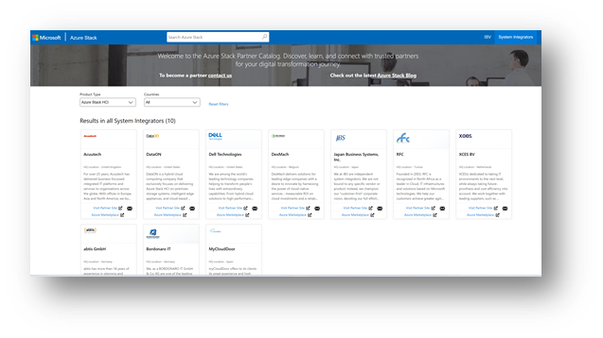
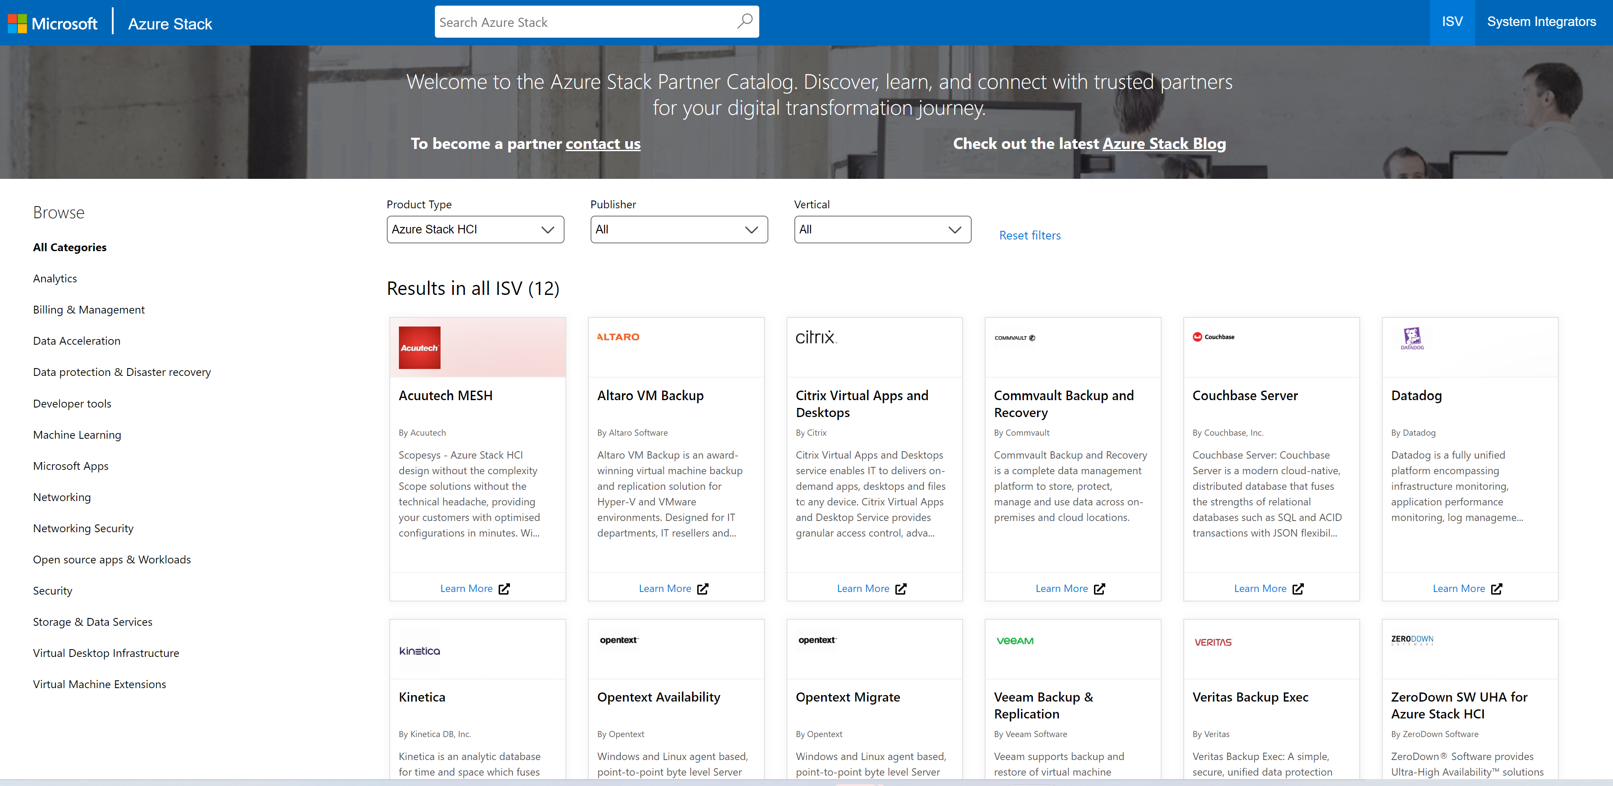
Azure Stack Partner Program
The Azure Stack Partner program is designed to create the foundation for Azure Stack business by recruiting, and nurturing ISV and SI partners around the world. The program provides community venues, trainings, and products update to Microsoft's Azure Stack ecosystem partners. “This is the program for ISVs and System Integrators who are interested in Azure Stack”
SI Program - Two Levels “Simple requirements”
ISV Program – One Level
Requirements
1) MPN
2) Co-sell ready Services / Solutions on the Azure Market Place
3) Annual case studies
(Public or under NDA)
Benefit
Access to Azure Stack partner community
Access to online training and webinar
Receive product update
Your company logo @ Azure Stack Partner Catalog
Access to Azure Stack HCI Accelerator Program (ASAP) for FY22
Requirement
Partner must have NDA
Partner must be a MPN member
Partner must have a product or solution or Services with the Azure Stack family
Partner must have a Microsoft Support Agreement in place
Benefit
A one-stop shop for all information concerning adoption with Azure Stack
Regular communications regarding key events, technologies, products and programs
Location for partners to showcase their Azure Stack solutions
Level 2
Requirement
1) MPN
Benefit
Access to Azure Stack partner community
Access to online training and webinar
Receive product update
Level 1
Azure Stack Partner Catalog - for Level 2 SI partners
Azure Stack Partner Catalog - for ISVs
aka.ms/ashcipartners
aka.ms/ashcisolutions
To learn more contact us aspartnerprogram@microsoft.com

Slide 28


Hybrid Infrastructure with Microsoft Azure Stack HCI advanced specialization
The Hybrid Infrastructure with Azure Stack HCI advanced specialization showcases your organization’s validated technical capabilities in deploying a hyperconverged infrastructure on-premises with connectivity to Azure using Azure Stack HCI.
Which partners are eligible?
What’s in it for partners?
Azure advanced specializations are available to Gold Cloud Platform competency partners who provide consulting and delivery services to customers.
Prioritization with Microsoft customers and sales teams
How do partners earn it?
Competitive differentiation
Meet
pre-requisites (telemetry)
Pass 3rd party audit
Earn the specialization for 1 year
Exclusive access to customer programs and incentives
Partners receive a customer-facing label showing the designation on their Microsoft Partner Directory profile.
Partner logos are highlighted on https://azure.microsoft.com/partners
Learn More about the Azure Stack HCI Advanced Specialization

Slide 29

Azure Stack HCI Accelerator Program (ASAP)
The Azure Stack HCI Accelerator Program (ASAP) is a strategic initiative designed in partnership with Intel for the Microsoft field to advance the Hybrid customer pipeline with Azure Stack HCI + Arc by delivering successful POCs and driving customer deployments through partner services.
Which customers are eligible?
Hybrid HCI + Arc opportunities targeted at Majors and SMC Corporate
ASAP benefits
POC
Engagement stage 2-VALIDATE or 3-COMMIT​
Customer has hardware or has access to needed hardware
Deployment
Engagement stage 4-ONBOARD or 5-REALIZE VALUE
Customer commitment for evidence required
Removes friction for field to accelerate sales
Must have Azure Stack HCI in the hybrid solution (i.e., Arc, Arc Enabled Services, AKS on Azure Stack HCI)
Must use an Azure Stack HCI partner
Minimum Potential Opportunity Size: 4 Nodes of Azure Stack HCI (Example: 1 x 4 Node cluster or 2 x 2 Node cluster)
POC can be smaller such as 1 or 2 Nodes
Funding based on Annual ACR potential from Azure Stack HCI meter
Maximum funding available for partner services: up to $35K
Exceptions for high visibility and multi-site opportunities reviewed on case-by-case basis
Connects customers to Azure Stack HCI partners
Proves the value of Hybrid with Azure Stack HCI + Arc
What is the process?
MS Seller nominates customers via OneAsk Program ID 1810
Planning & Logistics
POC or Deployment Execution
Understand customer requirements
Simplifies engagement and reduces costs to customers and partners
Questions? Contact the ASAP Team: asap_pmo@microsoft.com
In partnership with

Slide 30
Hybrid Accelerator Program (HAP) for Azure Stack
HAP Program Activities dedicated to ISVs
HAP Goals
Enablement
GTM
GTM
Increase # of ISV solutions optimized on Microsoft and Intel by 30%
Develop our Partners technical skill and help them build a compelling Hybrid Offering to GTM.
Provide and received feedback from Partners and Customers.
Incremental customer Azure + Intel optimized solution usage (ACR) of $10M
ISV Eligibility & Funding
Strategic | Manufacturing | HLS | FSI | Gov | Telco
Increase evidence portfolio by #10 public case studies/testimonials
Partner must have a product that interoperates with the Azure Stack family in a specific vertical.
Must have identified >3 customers opportunity for ISV solution on Microsoft Stack Platform.
Size of opportunity identified >1M ACR are eligible for up to $50K in funding for ISV services.
To learn more contact us aspartnerprogram@microsoft.com
Notes:
Partner Requirements
Partner must have a product or solution that interoperates with the Azure Stack family in a specific vertical.
Must have identified >3 customers opportunity for ISV solution on Microsoft Stack Platform.
Size of opportunity identified >1M ACR are eligible for up to $50K in funding for ISV services.
Partner must have NDA.
Partner must be a MPN member.
Partner must have a Microsoft Support Agreement in place.
Exceptions for high visibility and multi-site opportunities reviewed on case-by-case basis.
Partner Benefits
Regular communications regarding key events, technologies, products, and programs.
Location for partners to showcase their Azure Stack solutions.
Receive product updates.
Your company logo @ Azure Stack Partner Catalog.
Engineering and GTM support from Microsoft & Intel.
Access to ASAP (Azure Stack HCI Accelerator Program) and Joint customer engagement (Customer commitment for evidence required)

Slide 31
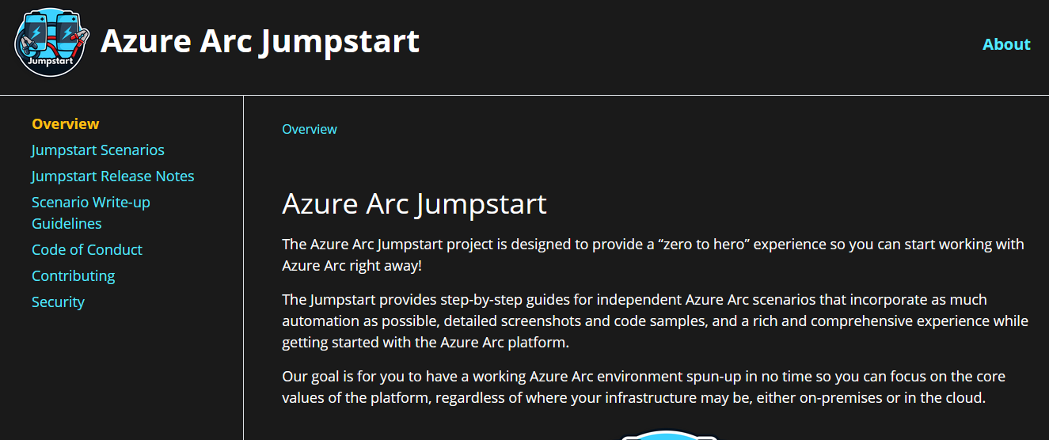
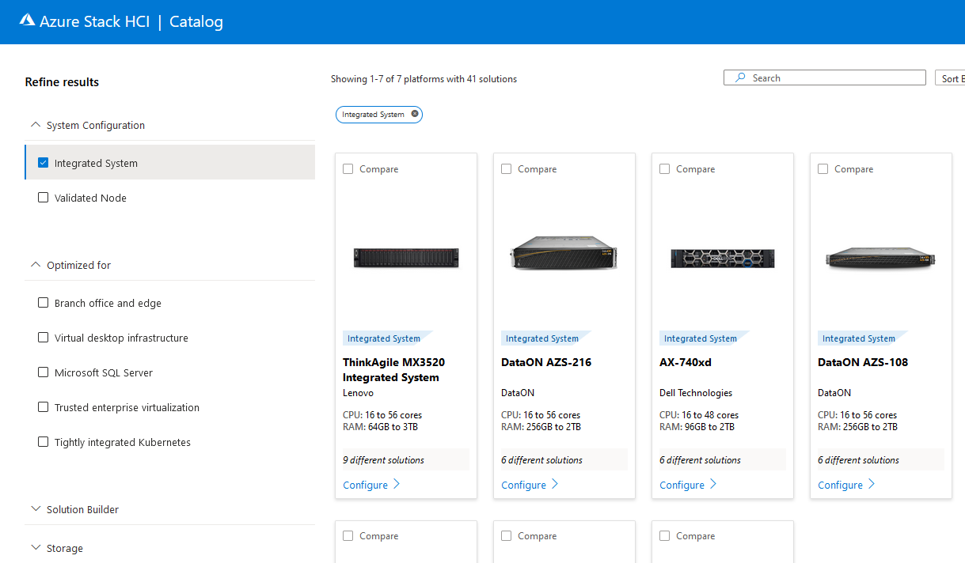
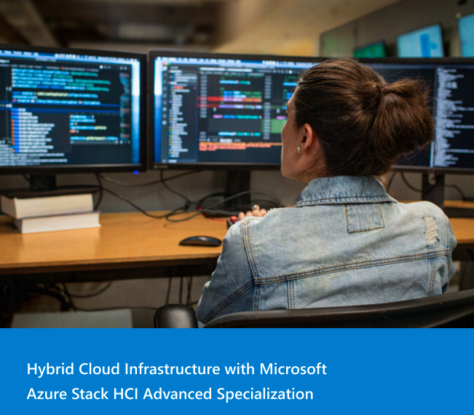
Next steps
Determine where Azure Arc and Azure Stack HCI fit in your practice as new sources of revenue
Start identifying and qualifying hybrid infrastructure opportunities
Get skilled up by joining the Azure Stack Partner Program and earn the Azure Hybrid Advanced Specializations
Talk to your partner account manager for more information about the Azure Stack HCI Accelerator Program for POCs and deployments
Check the Azure Stack HCI catalog aka.ms/azurestackhcicatalog and talk to your hardware partner of choice about Azure Stack HCI

